Slide 1

AI & Data Science with Python
ADY201m

Slide 2
Prerequisites
  Completed:
    PFP191
    DBI202

Slide 3
Course Objectives
Understand relational database concepts and foundational knowledge of the SQL language.
Define an overview of what Data science is today.
Know tools for Data science, know how to use at least one tool for Data science.

Slide 4
Course Objectives
Understand why we are interested in data science, what a methodology is, and why data scientists need a methodology.
Discusses Python fundamentals, Python libraries, and API support for Data science.
Explain the statistics for Data science: mean, median, mode, variance, and standard deviation, data visualization, regression analysis.

Slide 5
Course Objectives
Implement the small data science project by applying Python fundamentals, and Python data structures, and working with data in Python.

Slide 6
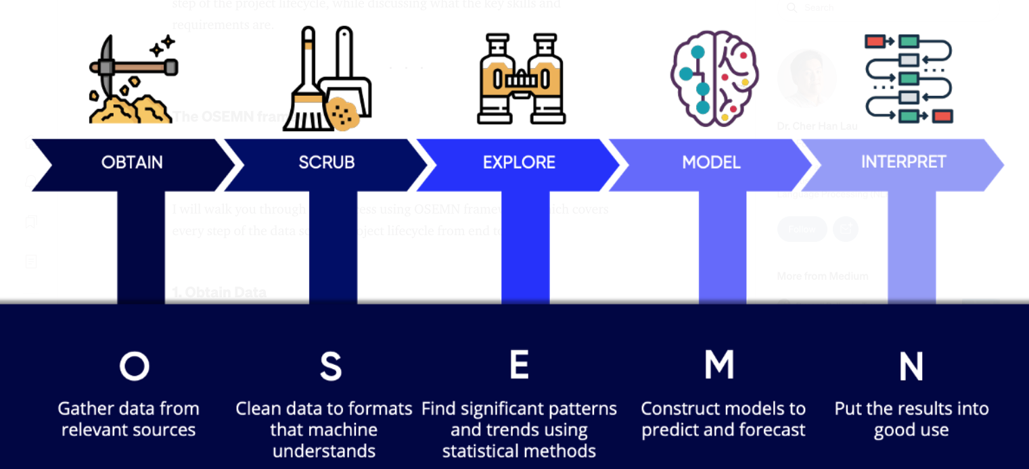
Course Objectives
Data Science Process

Slide 7
Course Plan
Introduction to Data Science
Data Science Topics
Data Science Methodology
From Problem to Approach and From Requirements to Collection

Slide 8
Course Plan
Understanding to Preparation and From Modeling to Evaluation
From Deployment to Feedback
Introduction to Relational Databases and Tables
Accessing Databases using Python, APIs, and Data Collection

Slide 9
Course Plan
Data Scientist's Toolkit: Python, R, Scala, and SQL.
Open Source Tools - GitHub, Jupyter Notebooks, and RStudio IDE
IBM Tools for Data Science- Watson Studio

Slide 10
Course Plan
Introduction & Descriptive Statistics
Data Visualization
Introduction to Probability Distributions
Regression Analysis

Slide 11
Course Plan
Data science steps: Data acquisition, cleaning, and aggregation
Data science steps: Exploratory data analysis, feature engineering
Data science project

Slide 12
Materials/ References
Required References- Coursera courses
  What is Data Science?
  Data Science Methodology
  Databases and SQL for Data Science with Python
  Tools for Data Science
  Python for Data Science, AI & Development
  Statistics for Data Science with Python
  Python Project for Data Science

Slide 13
Learning Environments
GitHub, Jupyter Notebooks, and RStudio IDE
Watson Studio.

Slide 14
Course Rules
How to conduct
  Prepare contents of the next session/ topic at home
  Following lessons in classrooms
  Completing chapter assessments in time and Quizzes (via LMS)
Communication
  Class
  Interchange by FU-HCM CMS, Forum
  Discussing actively in your teams and in classrooms
  Free to question and answer

Slide 15
Evaluation Strategy
Must attend more than 80% of contact hours
(if not, not allow to take exam).
Evaluating
  02 Progress Test (Q) 20 %
  Labs 30 %
  Assignment 20%
  Final Exam (FE) 30 %
Total score
  20% (Qiz)+ 30%( lab) + 20% (Assignment) + 30% (FE)
Pass
  Total score ≥ 5 and Final Examination ≥ 4 (of 10)
  Every components > 0

Slide 16
How to study
This course is complex knowledge (however, it’s attractive and exciting), so you need to keep tight grip on it
  Read
    On the books to get the general concept
    Reference, study, collection from anywhere else (internet, your classmates, forum …)
  Attend lectures
    Listens, understand, then make your own notes
    Give your explanation about some topic in lectures
    Ask questions
    Give some examples that are not existed in your book
    Practice all the exercises, demo to make your sense

Slide 17
How to study
  After classes
    Discuss your classmate in directly, on forum
    Do the lab, assignments to submit via CMS, and do more exercises
    Build your teams in yourselves to support together in studying

Slide 18
How to exam/test
This course is required following rules, so you need to focus and practice your exercises and homework in try your best everyday
  Progress Tests
    No books
    No conversations
  Workshop/Assignment
    Not copy (copy code, contents, style)

Slide 19
Academic policy
Cheating, plagiarism and breach of copyright are serious offenses under this Policy.
  Cheating
    Cheating during a test or exam is construed as talking, peeking at another student’s paper or any other clandestine method of transmitting information.
    Cheating during in making lab and assignment as copy source code, copy style, same meaning in progress, …

Slide 20
Academic policy
Cheating, plagiarism and breach of copyright are serious offenses under this Policy.
  Plagiarism
    Plagiarism is using the work of others without citing it; that is, holding the work of others out as your own work.
  Breach of Copyright
    If you photocopy a textbook without the copyright holder's permission, you violate copyright law.

Slide 21
Enjoy the Course
Be enthusiastic about the material because it is interesting, useful and an important part of your training.
Our job is to help you learn and enjoy the experience.
We will do our best but we need your help.
So, let’s all have fun together with
ADY201m!!!

Slide 22
Q & A

